Slide 1






Web Crawling- IIITD Resources
Group - 27
Anand(2020280)
Apoorva Agrawal(2020426)
Vaidik Kumar(2020346)

Slide 2

Introduction
The Internet has emerged as the most significant information source due to the network's explosive expansion in information. Research on extracting relevant knowledge from vast amounts of data is quite popular. Nonetheless, the primary objective of those studies is to gather pertinent data from the Internet through crawling web pages.
Thus, researchers suggested web crawlers to crawl web pages efficiently. Web crawler applications have existed for as long as the Internet. These are brief computer programs commonly referred to as "bots," "ants," or "worms," to download web pages, extract hyperlinks from them, compile a list of their URLs, and add them to a local database.
Place of Project
For Discussion: Google meet
For Documentation: Google Docs/excel, Canva, power point
For coding: PyCharm
Cost of Project: No Cost
Type: Software

Slide 3
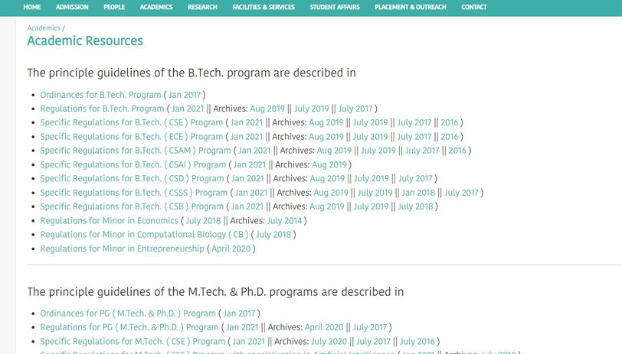
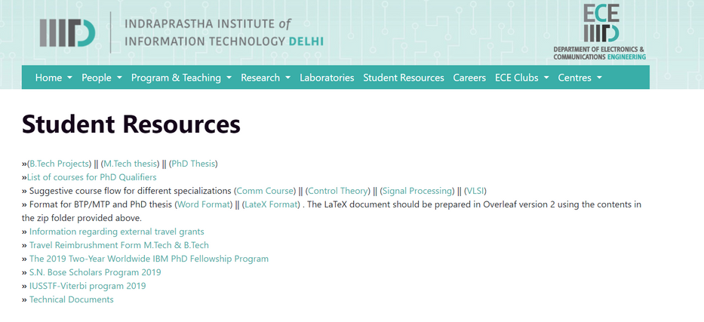
Problem Statement
During the coruse of college, one has to visit college website for different resources (link to library, erp, know course policy, pay fee payment).
The problem that we will solve is to "provide better, quick and relevant access to different resources that college provide online" based on the search query of the individual.

Slide 4
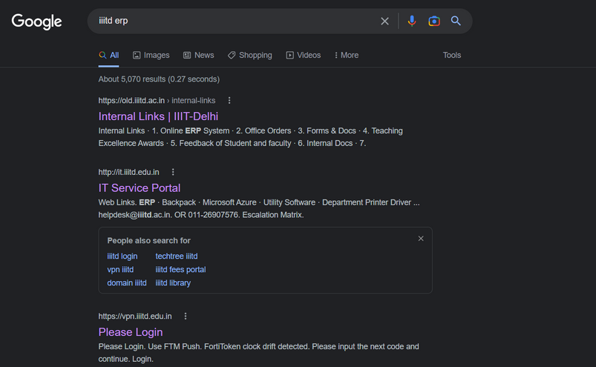
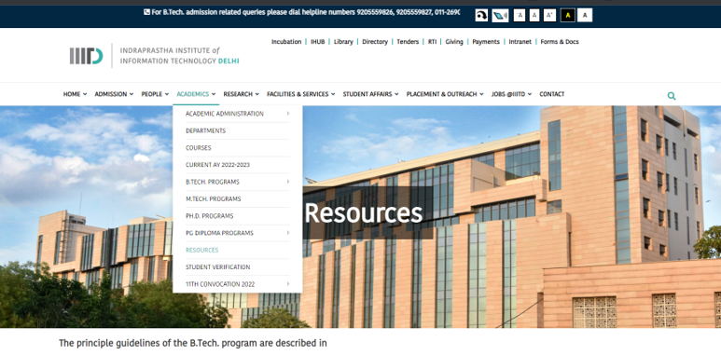
Motivation
It is based upon Real life scenario- while searching for various links like library, ERP, fee payment on IIITD but still not able to find it.
The webpage of IIITD- resources only provide link to course description and regulation. No mention of link to online library or techtree or any study material.
Spending so much time on finding links to different sections like Student Rources and still not able to find it.

Slide 5







Objective
Better and Faster result
Error and Optimization
Feasibility
Simple Search engine
Create a simple UI
Elimination

Slide 6
Our Solution
As our project is based on IIITD resources- it will only include things that are necessary for a student, like link to IIITD library, ERP, Techtree, etc.
It will be open source so that user with the knowledge to coding can modify it according to his needs.
Our solution is to "provide better, quick and relevant access to different resources that college provide online" based on the search query of the individual.
Our web crawler will scrape data from the IIITd website and store them in a listed view.
When the user puts a query, it will search the scrapped list and give the result.

Slide 7
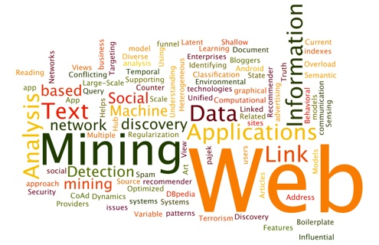
Work Plan
Zeroth Review
First Review
Final Review

Slide 8
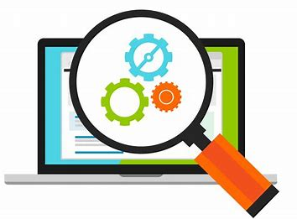
Methodology
Develop a web crawler
Creating crawler object
Creating crawler algorithm
Creating search engine object
Search engine implementation

Slide 9
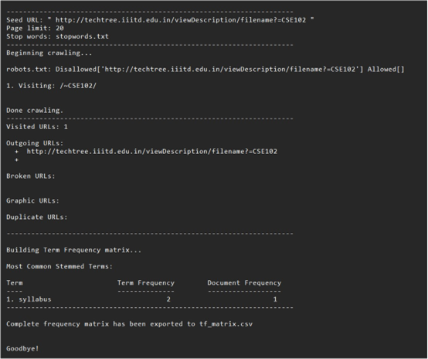
Baseline Result

Slide 10
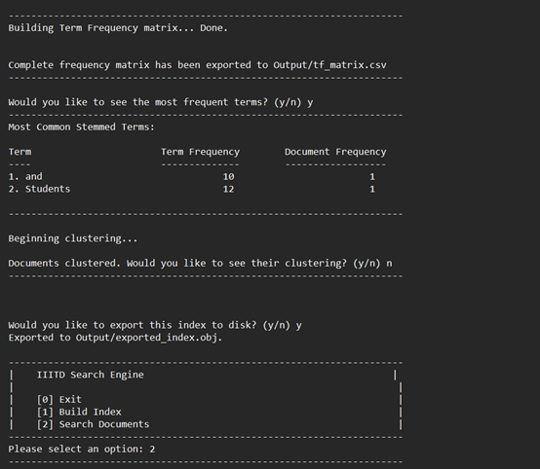
Final Result

Slide 11
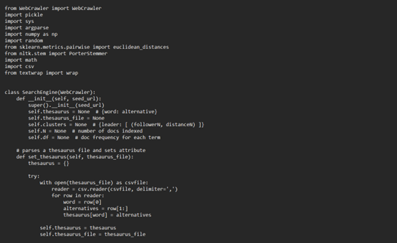
Part of code

Slide 12
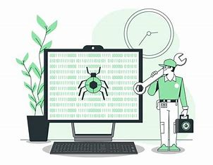
Difference Between Baseline and Final Review
Easier access
Indexing
Bugs
Search engine
Query- imported and exported
Better and faster
Optimization

Slide 13
Limitations
One may need more bandwidth or storage.
More information to handle at a time. (Hard to extract large data- like e-commerce websites.)
Some URLs might not be accessible to the user. And non-uniform structures.(webpages can be created using HTML, CSS, Java or PHP)
Learning Curve- All changes can be made to a web crawler with existing knowledge of web crawler.
If the website changes its HTML structure or content, it needs perpetual maintenance. (like IIITD changed its website from old to new)

Slide 14
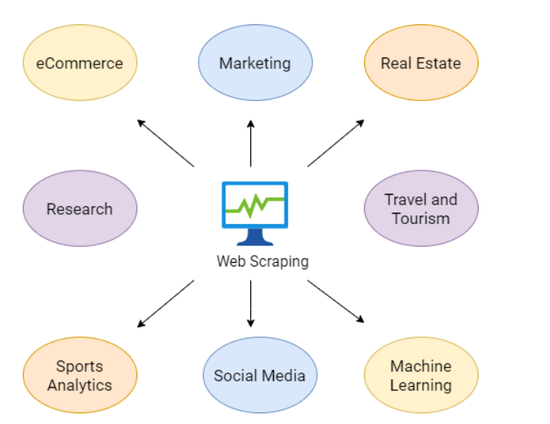
Existing Work
Used by Search Engines like Google.
Used by E-commerce websites to list products
Used in Data Analysis
Used for Betting Odds Analysis
Used for scrapping reviews and other scrapping need.

Slide 15

Thank You!

